Slide 1

Pub-Sub System using Kafka

Slide 2

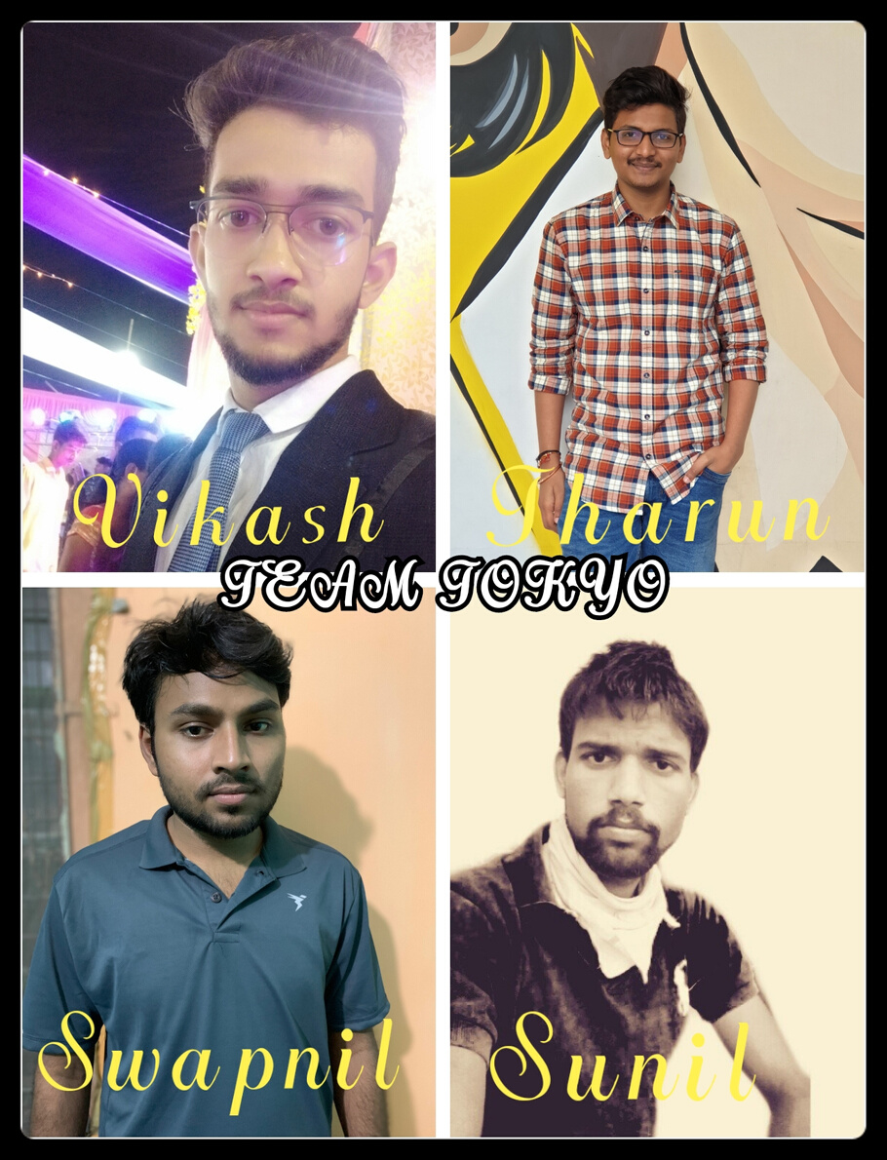
Group Members

Slide 3

Index
1. Challenge Timeline
2. Challenge Workflow
3. Producer Workflow
4. Consumer Workflow
5. Email Service
6. SMS Service
7. Fault Tolerance
8. LogRotation
9. Goroutine
10. UnitTestCoverage
11. Error Management

Slide 4





Challenge Timeline
Done Producer Service
Run Kafka with docker-compose
Divide work among group members
Done Fault Tolerance and Logging system
7 May 2020
10 May 2020
12 May 2020
16 May 2020
20 May 2020
23 May 2020
Learn Golang,Kafka and docker to build project
Done Consumer Service with email and sms integration
Added Viper and Unit Testcases
Deployment

Slide 5
Challenge Workflow
Kafka Ecosystem
Kafka Cluster
Pull msg
topic email
Consumer Group 1
Broker 1
Send email
Push msg
Broker 2
Producer
Pull msg
topic sms
Consumer Group 2
Send sms
Broker 3
Get Kafka Broker id
Updates Offset
Zookeeper

Slide 6
Producer Workflow
Main
Function for initialize Viper by giving its Path and file
Zaplog to Initialize logger for storing Pub-Sub logs
Handle Request when Postman request without Partition
Create KafkaWrite to write message request to Kafka
Write Message request to Kafka with given key
Handle response on postman for Msg request on Kafka
Handle Request when Postman request with Partition
Write Message request to given Partition in Kafka
Handle response on postman for Msg request on Kafka

Slide 7
Consumer Workflow
Email handler
Handle fault tolerance(HandleFailure)
handle Intial case when consumer up or new partition assignment(check)
printing various scenario to logger during during partition assignment and rebalancing
handle offset for particular partition after rebalancing in group(Offset Managment)
update the offset of provided partition when new message comes to partition
handle each and every case related to email coming from broker(Email Management)
SMS handler
Handle Fault Tolerance(HandleFailure)
handle message coming from goroutine(HandleMessagesParallel)
Send sms to customer(Send)

Slide 8
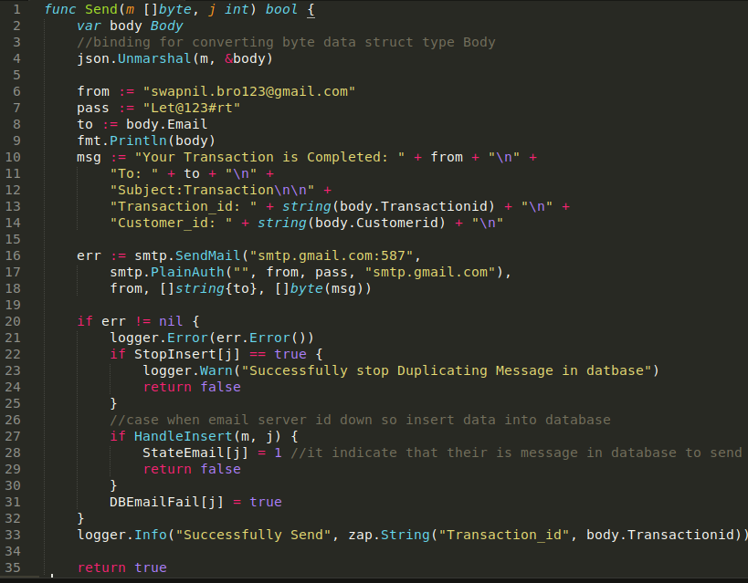
Email Service
1.
Send Email using google smtp server
2.
SMTP (Simple Mail Transfer Protocol) is a TCP/IP protocol used in sending and receiving e-mail
3.
Outgoing Mail (SMTP) Server: smtp.gmail.com
Username: My Gmail account
Password: My Gmail password
Port: 465 (SSL required) or 587 (TLS required)
4.
Transport Layer Security (TLS), and its now-deprecated predecessor, Secure Sockets Layer (SSL),are cryptographic protocols designed to provide communications security over a computer network.

Slide 9
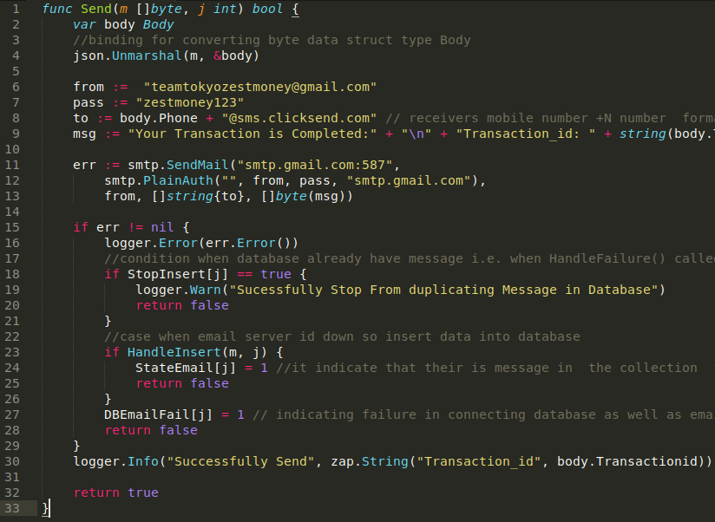
SMS Service
1.
Send sms using smtp google server and clicksend SMS
2.
ClickSend offer a powerful and flexible set of SMS APIs so you can programmatically send text messages
3.
SMS::ClickSend is a sms gateway for http://clicksend.us/

Slide 10
Fault Tolerance(Email)
Here, we adopting asynchronous strategy ,it means consumer will not commit messages after proceeding but after certain batch of messages
Case1:
when the consumer start after failure:
In that case it might possible ,that kafka send the messages that consumer procced it but not commited ,so we will handle this case storing offset in global database and when new message come ,we will simply update offset for particular partition otherwise we will poll for next message.
Case2: when email server id down:
We will store message in database and as soon as sever is up we will send batch of messages
Case3: both email and database for storing is down
In this case we will lost message ,so we simply return
Case4: offsetmanagement databse is down
In this case will commit every message i.e. synchronous receive

Slide 11
Fault Tolerance(Message)
1.
Strategy to handle messages from kafka-consumer group:
a.
We will send the messages to email-server if it fails then simply return
b.
We will store in database so that when email-service is up
c.
We can send the messages in database
d.
If in case of failure to connect mailserver and database at the same
e.
We simply return otherwise will loose the messages from kafka-consumer
2.
Kafka consumer will commit each message after proccessding so that when for some reason consumer is down and when it up ,it start from the last consumed message.
3.
We are running 3 parallel go-routine to handle messages from kafka broker
4.
Also when consumer is up ,first it will consume messages stored in database then it will start consuming messages
5.
Basically,it is synchronous process

Slide 12
Log Rotation
1.
Logrotate helps to manage all of our log files
2.
It can periodically read, minimize, back up, creates new log files, and basically anything you may ever want to do with them
3.
According to the documentation logrotate allows automatic rotation, compression, removal, and mailing of log files
4.
Each log file may be handled daily, weekly, monthly, or when it grows too large

Slide 13
Goroutine
1.
Goroutines are functions or methods that run concurrently with other functions or methods
2.
A WaitGroup allows to wait for a collection of goroutines to finish. The main goroutine calls Add to set the number of goroutines to wait for.At the same time, Wait can be used to block until all goroutines have finished
So, we use multiple go routine function to run processes in concurrently to minimize time

Slide 14
Unit Testcoverage
Framework: testing package- Go standard library testing support
Write TestCases with 100% accuracy for:
1.
OffsetManagement
2.
Producer
a.
Message send with Partition
b.
Message send without partition
c.
Message send with Key
d.
Message send without Key
3.
Consumer
a.
Send function
b.
HandleInsert Function

Slide 15
Error Management
1.
Kafka stopped after running in docker-compose file
Replace ${MY_IP} by (1)KAFKA_ZOOKEEPER_CONNECT: zk1, zk2 ,zk3 (2) KAFKA_ADVERTISED_LISTENERS: kafka1,kafka2,kafka3
Add line 127.0.0.1 kafka1 kafka2 kafka3 in /etc/hosts in linux
2.
race condition while handling three parallel goroutine, (when their is message in database , all goroutine try to send the messages
first think try mutex-lock,then realise,that it will cause other goroutine to sleep and does not utilise all resources so , create three different collection for three different goroutine.
3.
we are Handling two parrallel goroutine and we are commiting messages to kafka broker after every 8th message,we are facing problem when global database that we used for offset managment is down ,Suppose In that case if consumer is down ,so when consumer is up it will recieve duplicate messages
we handle this case by commiting each messages after proceeding

Slide 16

Thank You

